Slide 1
Scene name: Home page
Scene description: This is the first page of the mm application
MM description:
Animation of white part flows into the background.
Red colours will replace the white parts when the flow settles.
Buttons changing colour when
hover: alternate colour
click: fade
800x600 size
SQL ALIASES
VIEW TABLE
COURSEWARE 9
SQL - 3
QUERIES
JOIN
ADVANTAGES
INDEXES

Slide 2
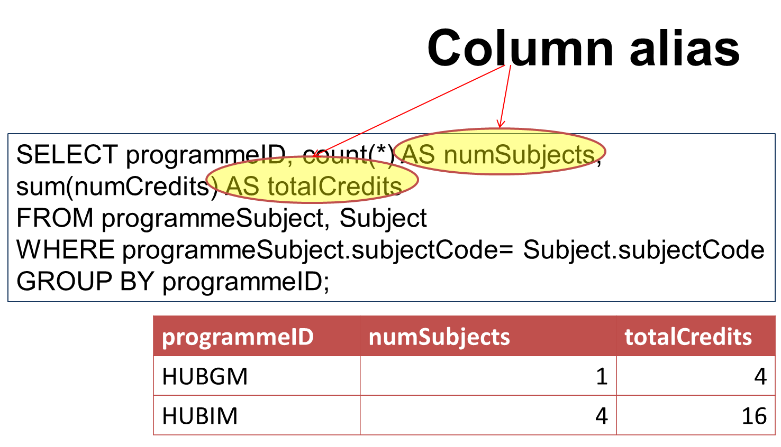



Scene name: SQL Aliases main page 1
Scene description: This is the 1st page of the 3rd main page of the mm application index
SQL
ALIASES
MM description:
‘‘Aliases ’‘ will appear at the banner area after clicking the button at the Home scene. This indicates that the user is viewing the ‘‘Aliases’’ scene.
‘’ views ’’ button clicked will take the user to that scene.
‘’Home’’ button clicked will take user back to Home scene.
‘’arrow to the right’’ button clicked will take user to the next scene of ‘’ Table Aliases ’’.
ALIASES
Aliases are used for
Columns
Tables
VIEWS

Slide 3
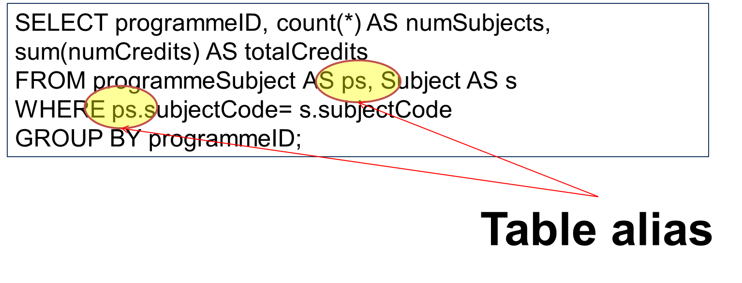
Scene name: Table Aliases page 2
Scene description: This is the 2nd page of the 3rd main page of Table Aliases page of the mm application queries
SQL
ALIASES
MM description:
‘‘Aliases ’‘ will appear at the banner area after clicking the button at the Home scene. This indicates that the user is viewing the ‘‘Aliases’’ scene.
‘’ views ’’ button clicked will take the user to that scene.
‘’Home’’ button clicked will take user back to Home scene.
‘’arrows to the right and left ’’ buttons clicked will take user to the next or the previous scene of “SQL Aliases ”
Animation will be applied for the query graphics.
ALIASES
Table Alias
A table alias is used to refer to a table by another name
To use the same table more than once in the query
VIEWS

Slide 4
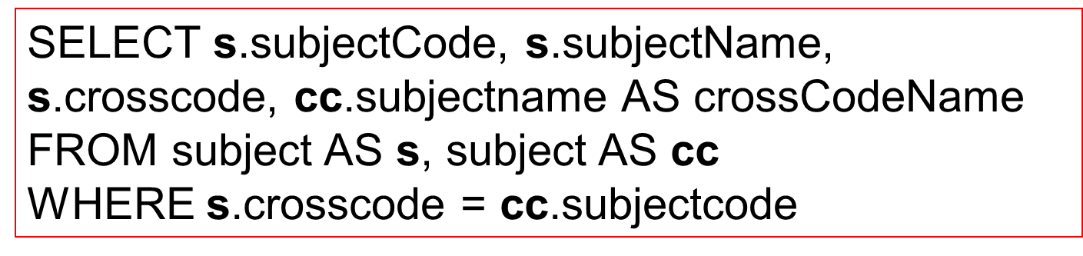

Scene name: Table Aliases page 3
Scene description: This is the 3rd page of the SQL Exercise page of the mm application
SQL
ALIASES
MM description:
‘‘Aliases ’‘ will appear at the banner area after clicking the button at the Home scene. This indicates that the user is viewing the ‘‘Aliases’’ scene.
‘’ views ’’ button clicked will take the user to that scene.
‘’Home’’ button clicked will take user back to Home scene.
‘’arrow to the left’’ button clicked will take user to the previous scene of the “Table Aliases ”
Animation will be applied for the query graphics.
ALIASES
SQL Exercise
For each subject is cross coded, list the subject code, subject name and the cross coded subject code and name
VIEWS

Slide 5
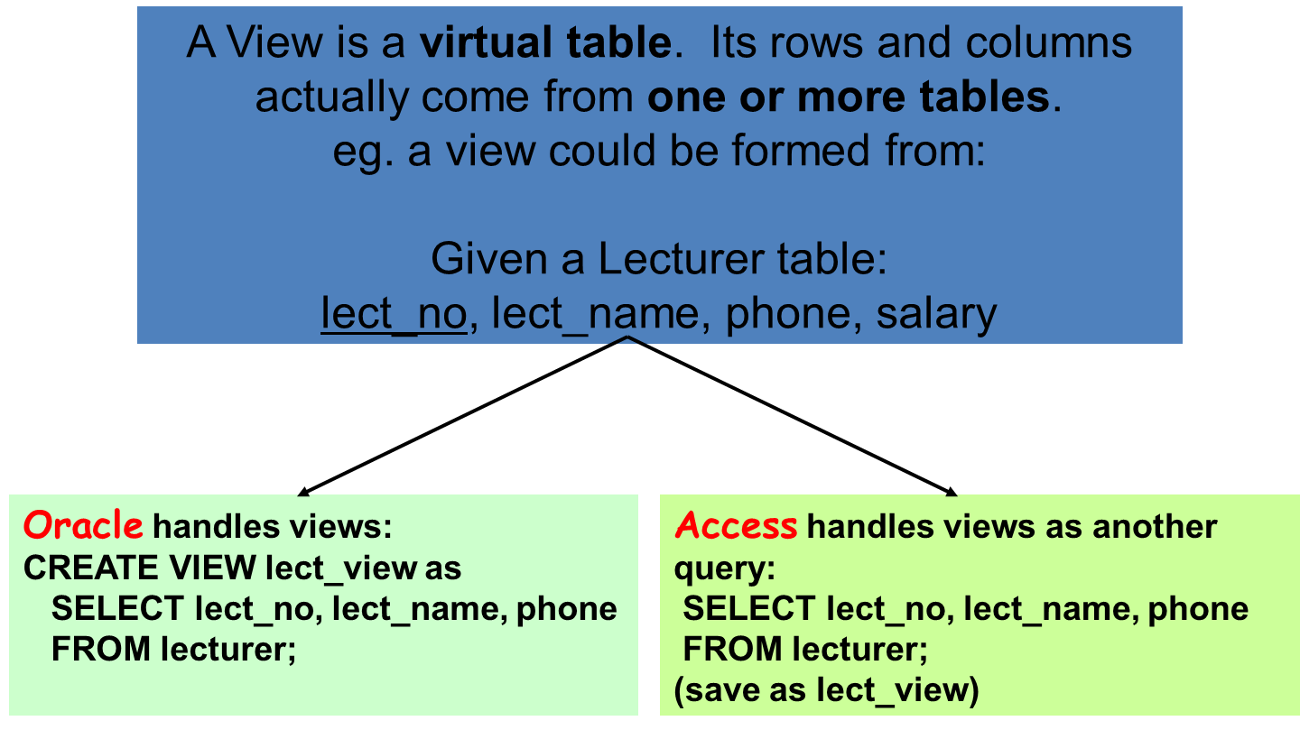
Scene name: Views main page 1
Scene description: This is the 1st page of the 4th main page of Views page of the mm application index
VIEW
TABLE
MM description:
‘‘Aliases ’‘ will appear at the banner area after clicking the button at the Home scene. This indicates that the user is viewing the ‘‘Aliases’’ scene.
‘’ views ’’ button clicked will take the user to that scene.
‘’Home’’ button clicked will take user back to Home scene.
‘’arrow to the right’’ button clicked will take user to the next scene of “Views definition “
VIEWS
ALIASES

Slide 6
Scene name: Views definition page 2
Scene description: This is the 2nd page of the definition page of the mm application index
VIEW
TABLE
MM description:
‘‘Aliases ’‘ will appear at the banner area after clicking the button at the Home scene. This indicates that the user is viewing the ‘‘Aliases’’ scene.
‘’ views ’’ button clicked will take the user to that scene.
‘’Home’’ button clicked will take user back to Home scene.
‘’arrows to the right and left ’’ buttons clicked will take user to the next or the previous scene of “Views definition”.
VIEWS
VIEWS
On most commerciaapplications , users work from views, and not directly from the tables.
A View is an application program’s or individual user’s picture of the database
Less involved than full database
  Simplification – focus on required data
  Security – omit sensitive information yet still able to manipulate other permitted parts of the table.
ALIASES

Slide 7
Scene name: View definition page 3
Scene description: This is the 3rd page of the definition page of the mm application index
VIEW
TABLE
MM description:
‘‘Aliases ’‘ will appear at the banner area after clicking the button at the Home scene. This indicates that the user is viewing the ‘‘Aliases’’ scene.
‘’ views ’’ button clicked will take the user to that scene.
‘’Home’’ button clicked will take user back to Home scene.
‘’arrows to the right and left ’’ buttons clicked will take user to the next or the previous scene of “Views definition ” of page 2
VIEWS
VIEWS (CONTINUED)
Defining query: SELECT command that creates a view. the view
Query acts as a window into the database
Does not produce a new table
Query that involves a view
  DBMS does not execute the query in this form
  Query actually executed is created by merging this query with the query that defines the view
ALIASES

Slide 8
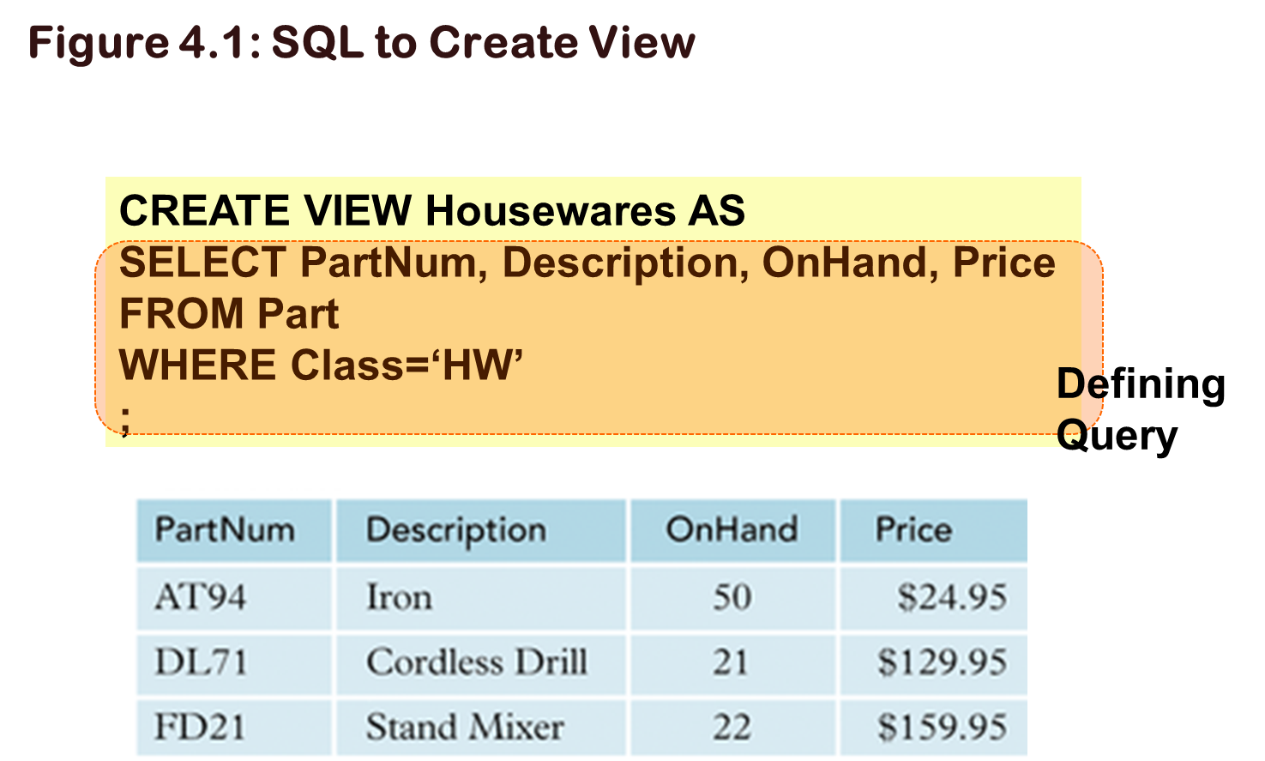
Scene name: View create page 4
Scene description: This is the only page of the create page of the mm application index
VIEW
TABLE
MM description:
‘‘Aliases ’‘ will appear at the banner area after clicking the button at the Home scene. This indicates that the user is viewing the ‘‘Aliases’’ scene.
‘’ views ’’ button clicked will take the user to that scene.
‘’Home’’ button clicked will take user back to Home scene.
‘’arrow to the left’’ button clicked will take user to the previous scene of the “View definition”
Animation will be applied for the query graphics.
VIEWS
ALIASES

Slide 9
Scene name: View Table Queries main page
Scene description: This is the 1st page of the 3rd main page of the mm application queries
QUERIES
MM description:
‘‘View table queries’‘ will appear at the banner area after clicking the button at the Home scene. This indicates that the user is viewing the ‘‘view table queries’’ scene.
‘’ view table join’’ button clicked will take the user to that scene.
‘’Advantages of view’’ button clicked will take the user to that scene.
‘’Home’’ button clicked will take user back to Home scene.
‘’arrow to the right’’ button clicked will take user to the next scene of ‘’view table queries’’.
VIEW TABLE QUERIES
Query on a View
With a query that involves a view the DBMS changes the query to one that select data from table(s) in the database that created the view .
The DBMS merges the query that defines the view to form the query that is actually executed.
One advantage of this approach is that the view never exists in its own right so any update to the table is immediately available in the view.
If the view were a table, this would not be the case
VIEW TABLE JOIN
ADVANTAGES OF VIEWS

Slide 10
Scene name: View Table Queries page 2
Scene description: This is the 2nd page of the 3rd main page of view table queries the mm application queries
QUERIES
MM description:
‘‘View table queries’‘ will appear at the banner area after clicking the button at the Home scene. This indicates that the user is viewing the ‘‘view table queries’’ scene.
‘’ view table join’’ button clicked will take the user to that scene.
‘’Advantages of view’’ button clicked will take the user to that scene.
‘’Home’’ button clicked will take user back to Home scene.
‘’arrows to the right and left ’’ buttons clicked will take user to the next or previous scene of ‘’view table queries’’.
Animation will be applied for the query graphics.
VIEW TABLE QUERIES
Query on a View
Selects data only from Tables created in the view
Query is merged with query used to create view
VIEW TABLE JOIN
ADVANTAGES OF VIEWS
SELECT *
FROM Housewares
WHERE OnHand< 25
;
Actually executes as
SELECT PartNum, Description, OnHand, Price
FROM Part
WHERE Class=‘HW’
AND OnHand< 25
;

Slide 11

Scene name: View Table Queries page 3
Scene description: This is the 3rd page of the 3rd main page of the mm application queries
QUERIES
MM description:
‘‘View table queries’‘ will appear at the banner area after clicking the button at the Home scene. This indicates that the user is viewing the ‘‘view table queries’’ scene.
‘’ view table join’’ button clicked will take the user to that scene.
‘’Advantages of view’’ button clicked will take the user to that scene.
‘’Home’’ button clicked will take user back to Home scene.
‘’arrow to the left’’ button clicked will take user to the previous scene of ‘’view table queries’’.
Animation will be applied for the query graphics.
VIEW TABLE QUERIES
Access Query Design View with Changed Field Names:
SQL can be used to change the field names in a view by including the new field names in the CREATE VIEW statement
The CREATE VIEW statement would be:
VIEW TABLE JOIN
ADVANTAGES OF VIEWS
CREATE VIEW
Housewares (Pnum, PDesc, OnHd, Price) AS
SELECT PartNum, Description, OnHand, Price
FROM Part
WHERE Class=‘HW’

Slide 12
Scene name: View table join main page
Scene description: This is the 1st page of the 4th main page of the mm application join
JOIN
MM description:
‘‘View table join’‘ will appear at the banner area after clicking the button at the Home scene. This indicates that the user is viewing the ‘‘view table join’’ scene.
‘’ view table queries’’ button clicked will take the user to that scene.
‘’Advantages of view’’ button clicked will take the user to that scene.
‘’Home’’ button clicked will take user back to Home scene.
‘’arrow to the right’’ button clicked will take user to the next scene of ‘’view table join’’.
Animation will be applied for the query graphics.
VIEW TABLE JOIN
Example:
Creating a view with the rep num, last name, first name, customer num and customer name, joining both the Customer and Rep tables:
VIEW TABLE QUERIES
ADVANTAGES OF VIEWS
CREATE VIEW
SalesCust (Snum, SLast, SFirst, Cnum, CName) AS
SELECT Rep.RepNum, LastName, FirstName,
CustomerNum, CustomerName
FROM Rep, Customer
WHERE Rep.RepNum=Customer.RepNum
;

Slide 13
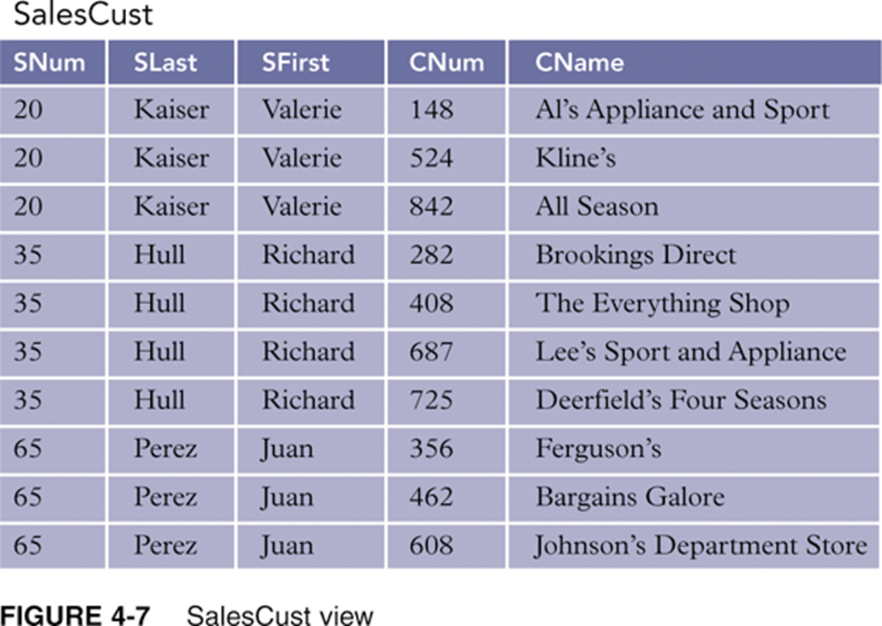
Scene name: View table join page 2
Scene description: This is the 2nd page of the 4th main page of the mm application join resulting view
JOIN
MM description:
‘‘View table join’‘ will appear at the banner area after clicking the button at the Home scene. This indicates that the user is viewing the ‘‘view table join’’ scene.
‘’ view table queries’’ button clicked will take the user to that scene.
‘’Advantages of view’’ button clicked will take the user to that scene.
‘’Home’’ button clicked will take user back to Home scene.
‘’arrow to the left’’ button clicked will take user to the previous scene of ‘’view table join’’.
Animation will be applied for the table graphics.
VIEW TABLE JOIN
Resulting view
VIEW TABLE QUERIES
ADVANTAGES OF VIEWS

Slide 14
Scene name: Advantages of views main page
Scene description: This is the 1st page of the 5th main page of the mm application advantages of view
ADVANTAGES
MM description:
‘‘Advantages of views’‘ will appear at the banner area after clicking the button at the Home scene. This indicates that the user is viewing the ‘‘Advantages of views’’ scene.
‘’ view table queries’’ button clicked will take the user to that scene.
‘’view table join’’ button clicked will take the user to that scene.
‘’Home’’ button clicked will take user back to Home scene.
‘’arrow to the right’’ button clicked will take user to the next scene of ‘Advantages of views’’.
ADVANTAGES OF VIEWS
can structure the data in the way users want it, and not as dictated by normalisation.
an extra dimension of data independence.
For example, suppose we split the table STUDENT-ROOM (studentID, name, room-no, location, no-beds) into 2 tables STUDENT and ROOM.
We would then have to change the defining of the structure of the view so it looks at both STUDENT and ROOM. But what the user sees remains the same.
security. Could leave out sensitive fields from the views.
VIEW TABLE QUERIES
VIEW TABLE JION

Slide 15
Scene name: Advantages of views page 2
Scene description: This is the 2nd page of the 5th main page of the mm application advantages of view
ADVANTAGES
MM description:
‘‘Advantages of views’‘ will appear at the banner area after clicking the button at the Home scene. This indicates that the user is viewing the ‘‘Advantages of views’’ scene.
‘’ view table queries’’ button clicked will take the user to that scene.
‘’view table join’’ button clicked will take the user to that scene.
‘’Home’’ button clicked will take user back to Home scene.
‘’arrow to the left’’ button clicked will take user to the previous scene of ‘Advantages of views’’.
ADVANTAGES OF VIEWS
views can have derived attributes which can save on doing calculations in SQL.
SELECT length, width, (length * width) as area
FROM rectangle;
(save as rect_view)
NOTE: On most commercial applications, users work from views, and not directly from the tables.
VIEW TABLE QUERIES
VIEW TABLE JION

Slide 16
Scene name: Index main page
Scene description: This is the 1st page of the 6th main page of the mm application index
INDEXES
MM description:
‘‘Indexes’‘ will appear at the banner area after clicking the button at the Home scene. This indicates that the user is viewing the ‘‘Definition’’ scene.
Side buttons will direct to the desired part of indexes
‘’Home’’ button clicked will take user back to Home scene.
‘’arrow to the left’’ button cannot be clicked indicated by the grey colour.
DEFINITION
What is an index?
Conceptually similar to book index
Increase data retrieval efficiency
Record numbers automatically assigned and used by DBMS
Index key: field or combination of fields on which index is built
ADVANTAGES & DISADVANTAGES
GUIDELINES
CREATE/DELETE
MULTIPLE FIELDS

Slide 17
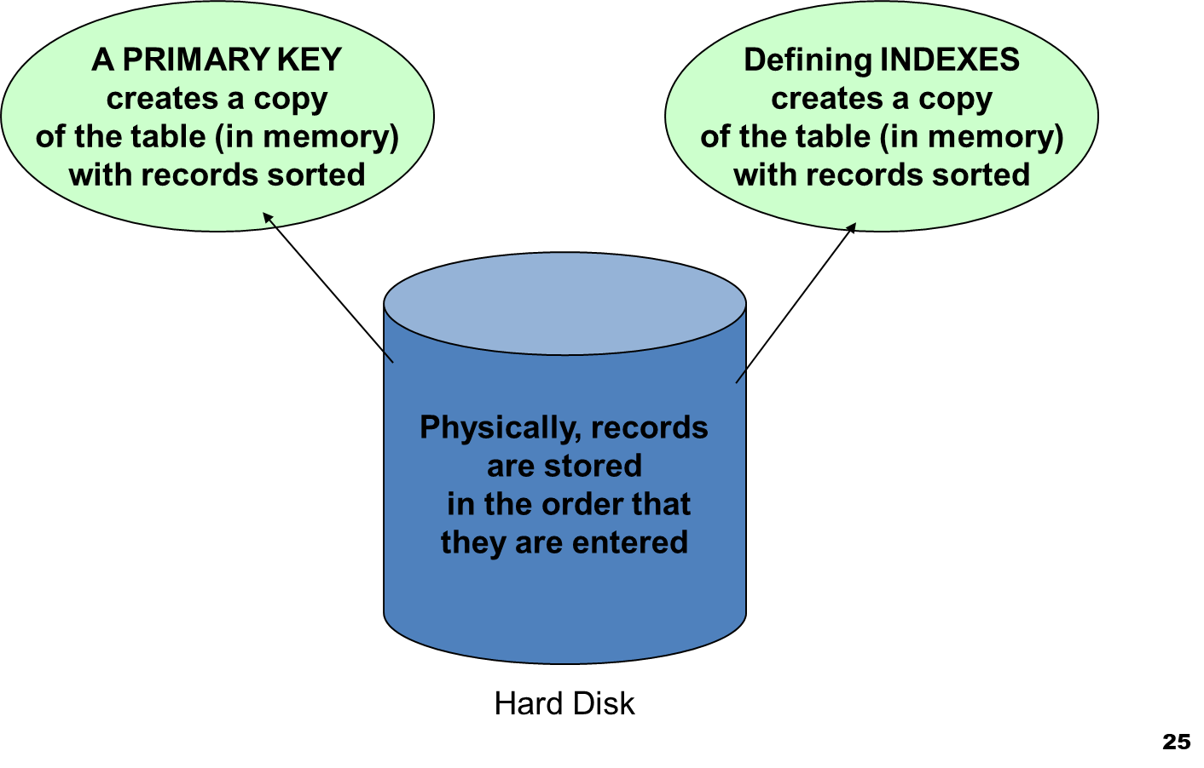

Scene name: Index definition page 2
Scene description: This is the 2nd page of the index definition page of the mm application
INDEXES
MM description:
‘‘Indexes’‘ will appear at the banner area after clicking the button at the Home scene. This indicates that the user is viewing the ‘‘Definition’’ scene.
Side buttons will direct to the desired part of indexes
‘’Home’’ button clicked will take user back to Home scene.
‘’arrow to the right’’ button clicked will be highlighted by red border and white fill.
DEFINITION
ADVANTAGES & DISADVANTAGES
GUIDELINES
CREATE/DELETE
MULTIPLE FIELDS

Slide 18
Scene name: Index advantage & disadvantage page 1
Scene description: This is the 1st advantage page of the adv & disadv page of the mm application index
INDEXES
MM description:
‘‘Indexes’‘ will appear at the banner area after clicking the button at the Home scene. This indicates that the user is viewing the ‘‘advantages&disadvatages’’ scene.
Side buttons will direct to the desired part of indexes
‘’Home’’ button clicked will take user back to Home scene.
‘’arrow to the left” button cannot be clicked indicated by the grey colour.
ADVANTAGES & DISADVANTAGES
ADVANTAGES
Can be added or dropped without loss of function
Can make retrieval more efficient, especially for large databases which thousands of records or more.
DEFINITION
GUIDELINES
CREATE/DELETE
MULTIPLE FIELDS

Slide 19
Scene name: Index advantage & disadvantage page 2
Scene description: This is the 2nd disadvantage page of the adv & disadv page of the mm application index
INDEXES
MM description:
‘‘Indexes’‘ will appear at the banner area after clicking the button at the Home scene. This indicates that the user is viewing the ‘‘advantages&disadvantages’’ scene.
Side buttons will direct to the desired part of indexes
‘’Home’’ button clicked will take user back to Home scene.
‘’arrow to the right’’ button clicked will be highlighted by red border and white fill.
ADVANTAGES & DISADVANTAGES
DISADVANTAGES
Occupies space that might be required for other functions
DBMS must update index whenever corresponding data are updated
DEFINITION
GUIDELINES
CREATE/DELETE
MULTIPLE FIELDS

Slide 20

Scene name: Index guidelines page
Scene description: This is the only page of the guidelines page of the mm application index
INDEXES
MM description:
‘‘Indexes’‘ will appear at the banner area after clicking the button at the Home scene. This indicates that the user is viewing the ‘‘guidlines’’ scene.
Side buttons will direct to the desired part of indexes
‘’Home’’ button clicked will take user back to Home scene.
‘’arrow to the left and right’’ button cannot be clicked indicated by the grey colour.
GUIDELINES
An index should be created when one or more of the following conditions exist:
Field is the primary key of the table
Field is the foreign key in a relationship
Field will be frequently used as a sort field
Need to frequently locate a record based on a value in this field
DEFINITION
ADVANTAGES & DISADVANTAGES
CREATE/DELETE
MULTIPLE FIELDS

Slide 21
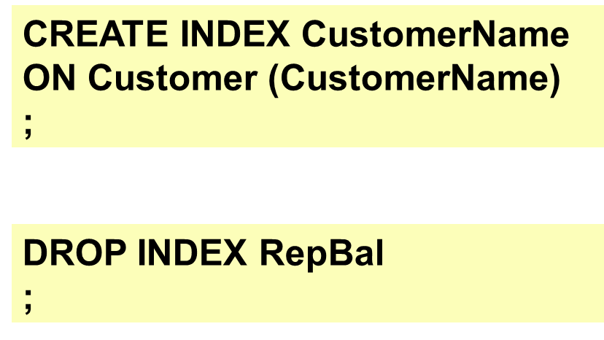
Scene name: Index create/delete page
Scene description: This is the only page of the create/delete page of the mm application index
INDEXES
MM description:
‘‘Indexes’‘ will appear at the banner area after clicking the button at the Home scene. This indicates that the user is viewing the ‘‘create/delete’’ scene.
Side buttons will direct to the desired part of indexes
‘’Home’’ button clicked will take user back to Home scene.
‘’arrow to the left and right’’ button cannot be clicked indicated by the grey colour.
CREATE/DELETE
DEFINITION
ADVANTAGES & DISADVANTAGES
GUIDELINES
MULTIPLE FIELDS

Slide 22
Scene name: Index multiple fields page 1
Scene description: This is the 1st page of the multiple fields page of the mm application index
INDEXES
MM description:
‘‘Indexes’‘ will appear at the banner area after clicking the button at the Home scene. This indicates that the user is viewing the ‘‘multiple fields’’ scene.
Side buttons will direct to the desired part of indexes
‘’Home’’ button clicked will take user back to Home scene.
‘’arrow to the left” button cannot be clicked indicated by the grey colour.
MULTIPLE FIELDS
An index with a single field as the key is a single-field index.
A multiple-field (or multiple-column) index is an index with more than one key field.
List the more important key first.
If key appears in descending order use DESC
DEFINITION
GUIDELINES
CREATE/DELETE
ADVANTAGES & DISADVANTAGES

Slide 23
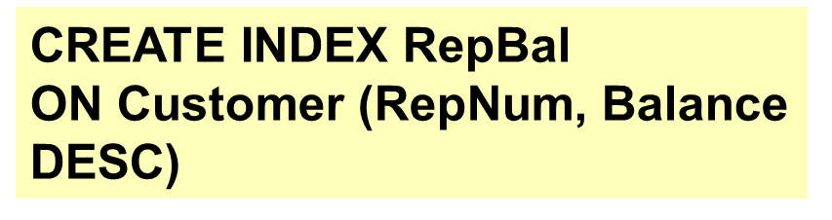
Scene name: Index multiple fields page 2
Scene description: This is the 2nd page of the multiple fields page of the mm application index
INDEXES
MM description:
‘‘Indexes’‘ will appear at the banner area after clicking the button at the Home scene. This indicates that the user is viewing the ‘‘multiple fields’’ scene.
Side buttons will direct to the desired part of indexes
‘’Home’’ button clicked will take user back to Home scene.
‘’arrow to the right’’ button clicked will be highlighted by red border and white fill.
MULTIPLE FIELDS
Example: creating an index named RepBal with the keys RepNum and Balance and balances in descending order:
DEFINITION
GUIDELINES
CREATE/DELETE
ADVANTAGES & DISADVANTAGES

